Slide 1
IGHT DYNAMICS
FL
YING FOX
077BAS005 BIBEK YONZAN
077BAS023 MANISH TAJPURIYA
077BAS042 SIMONKRITH LAMICHHANE
077BAS043 SIMRAN PAUDEL

Slide 2
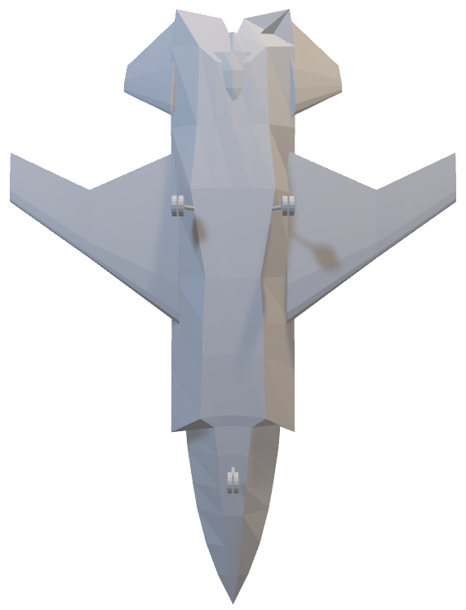
Unmanned
Multirole
High speed
High maneuverability
FL
YING FOX
Combat Aerial Vehicle

Slide 3
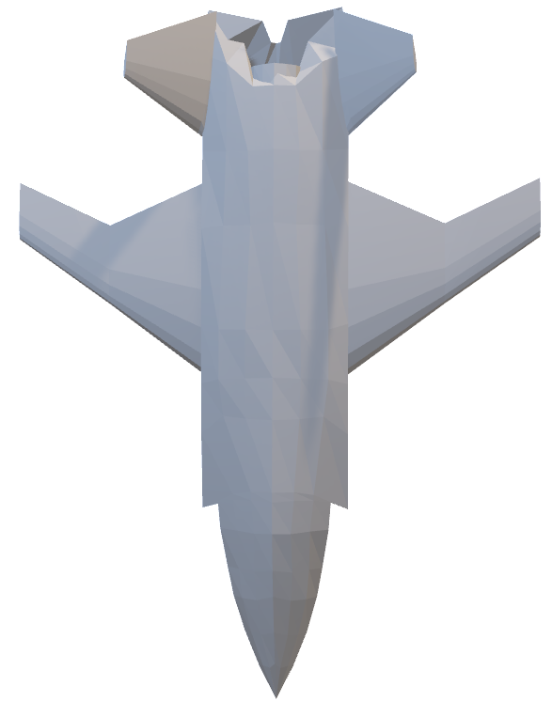
YING FOX
FL
Unmanned
Multirole
High speed
High maneuverability
Combat Aerial Vehicle
Surveillance
Reconnaissance
Wingman

Slide 4
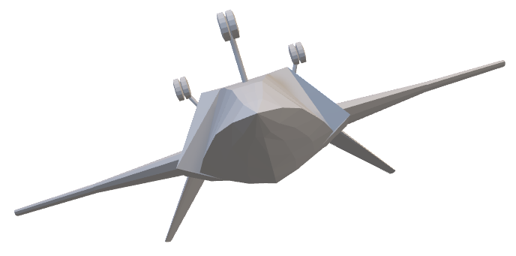
YING FOX MISSION PROFILE
YING FOX
FL
Unmanned
Multirole
High speed
High maneuverability
Combat Aerial Vehicle
Surveillance
Reconnaissance
Wingman

Slide 5
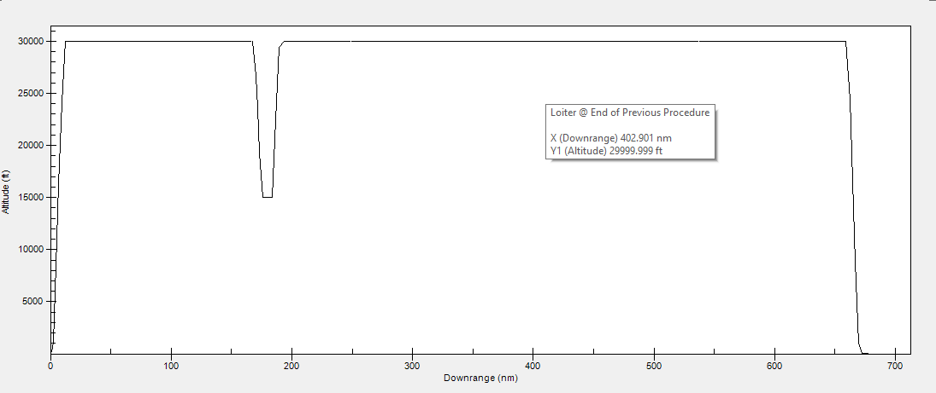

YING FOX
FL
MISSION PROFILE
Unmanned
Multirole
High speed
Takeoff & Climb
W1/W0 = 0.97
W2/W1 = 0.985
High maneuverability
Combat Aerial Vehicle
Surveillance
Reconnaissance
Wingman

Slide 6

YING FOX
FL
MISSION PROFILE
Unmanned
Multirole
Cruise
W2/W1 = 0.985
High speed
Takeoff & Climb
W1/W0 = 0.97
W2/W1 = 0.985
High maneuverabilty
Combat Aerial Vehicle
Surveillance
Reconnaisance
972
Wingman

Slide 7
YING FOX
FL
MISSION PROFILE
Unmanned
Multirole
Cruise
W3/W2 = 0.9999
High speed
High maneuverabilty
Combat
W3/W2 = 0.9999
Takeoff & Climb
W1/W0 = 0.97
W2/W1 = 0.985
Combat Aerial Vehicle
Surveillance
Reconnaisance
972
Wingman

Slide 8
YING FOX
FL
MISSION PROFILE
Unmanned
Multirole
Cruise
W3/W2 = 0.9999
Cruise & Loiter
W5/W4 = 0.9999
W6/W5 = 0.8588
High speed
High maneuverabilty
Combat
W4/W3 = 0.9849
Takeoff & Climb
W1/W0 = 0.97
W2/W1 = 0.985
Combat Aerial Vehicle
Surveillance
Reconnaisance
972
Wingman

Slide 9
YING FOX
FL
MISSION PROFILE
Unmanned
Multirole
Cruise
W3/W2 = 0.9999
Cruise & Loiter
W5/W4 = 0.9999
W6/W5 = 0.8588
High speed
High maneuverabilty
Combat
Combat
W4/W3 = 0.9849
Takeoff & Climb
W1/W0 = 0.97
W2/W1 = 0.985
Combat Aerial Vehicle
Descent & Land
W7/W6 = 0.995
Surveillance
Reconnaisance
972
Wingman

Slide 10
YING FOX
FL
MISSION PROFILE
Unmanned
Multirole
Cruise
W3/W2 = 0.9999
Cruise & Loiter
Cruise & Loiter
W5/W4 = 0.9999
W6/W5 = 0.8588
High speed
High maneuverabilty
Combat
Takeoff & Climb
W1/W0 = 0.97
W2/W1 = 0.985
Combat
W4/W3 = 0.9849
Combat Aerial Vehicle
Descent & Land
W7/W6 = 0.995
Wto = 2950 kg
Wf = 578.3475 kg
We = 2371.653
Surveillance
Reconnaisance
Wingman

Slide 11
YING FOX
FL
MISSION PROFILE
Unmanned
Multirole
Cruise
W3/W2 = 0.9999
Cruise & Loiter
Cruise & Loiter
W5/W4 = 0.9999
W6/W5 = 0.8588
High speed
High maneuverabilty
Combat
Takeoff & Climb
W1/W0 = 0.97
W2/W1 = 0.985
Combat
W4/W3 = 0.9849
Combat Aerial Vehicle
Descent & Land
W7/W6 = 0.995
Wto = 2950 kg
Surveillance
Reconnaisance
Wingman

Slide 12
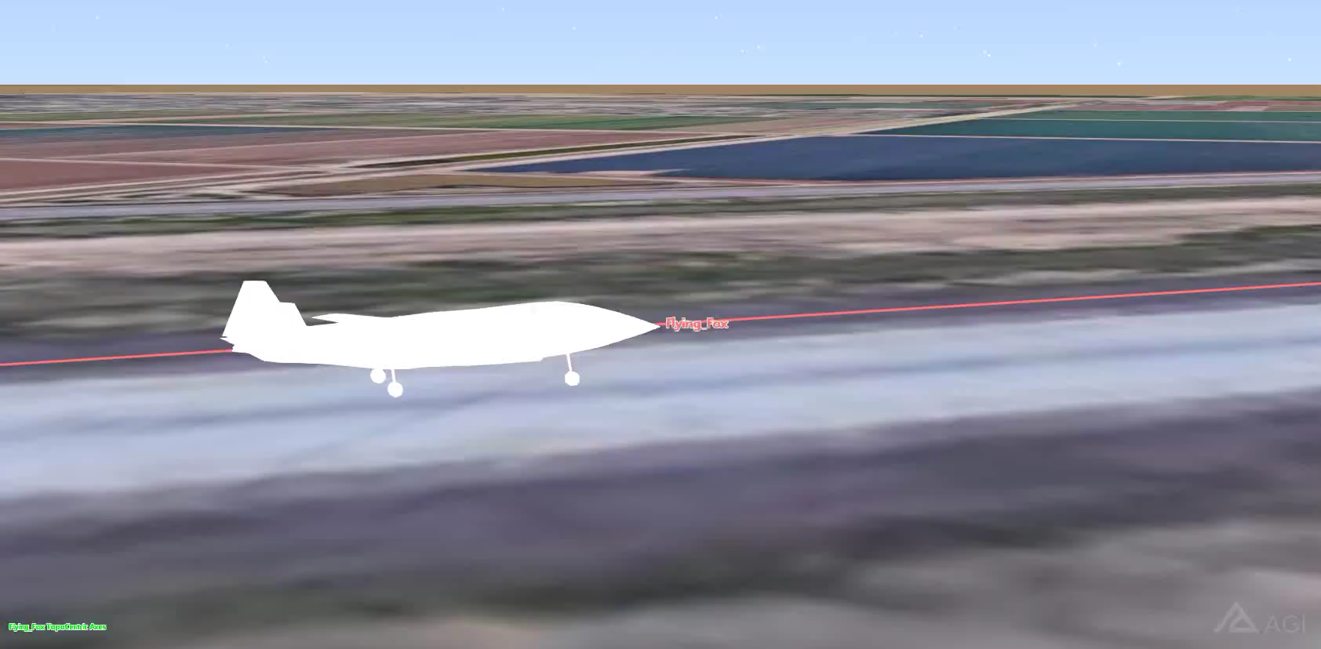

YING FOX
FL
MISSION PROFILE
Unmanned
Multirole
Cruise
W3/W2 = 0.9999
Cruise & Loiter
Cruise & Loiter
W5/W4 = 0.9999
W6/W5 = 0.8588
High speed
High maneuverabilty
Takeoff & Climb
W1/W0 = 0.97
W2/W1 = 0.985
Combat
Combat
W4/W3 = 0.9849
Combat Aerial Vehicle
Descent & Land
W7/W6 = 0.995
Wto = 2950 kg
Surveillance
Reconnaisance
Wingman

Slide 13
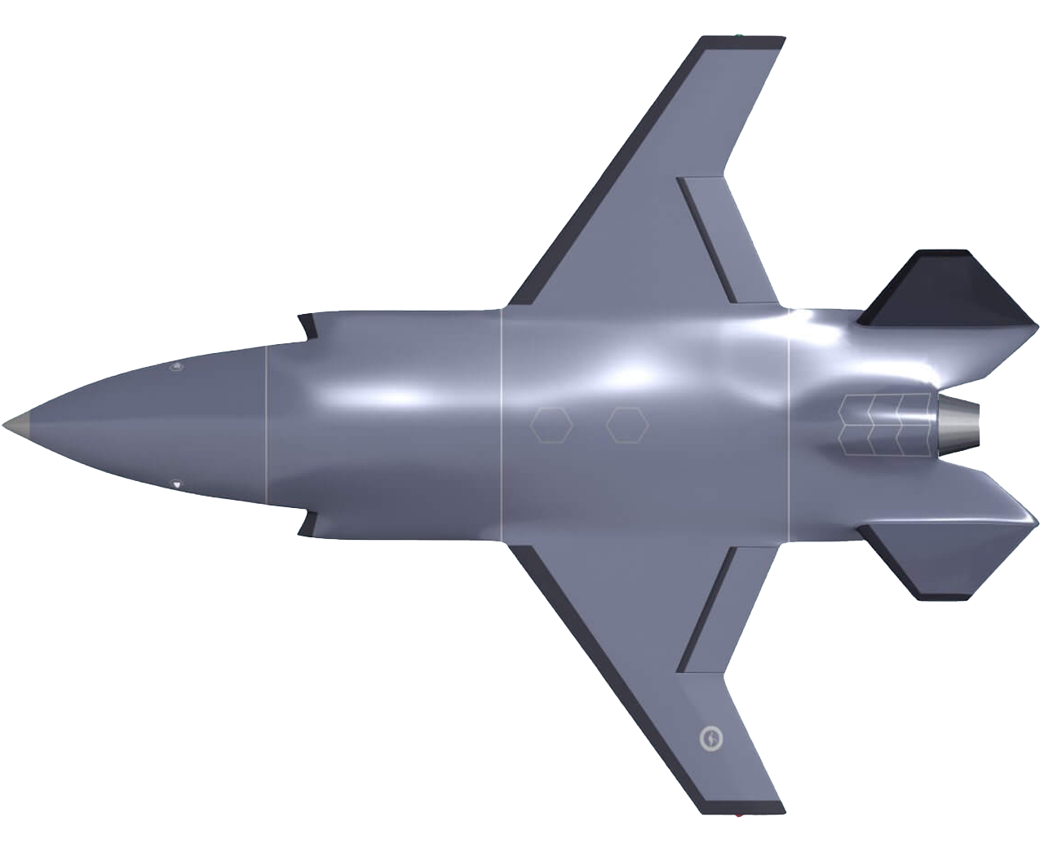
PLANEMAKER

Slide 14
PLANEMAKER

Slide 15
PLANEMAKER

Slide 16
PLANEMAKER

Slide 17
PLANEMAKER

Slide 18
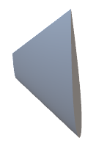
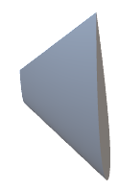

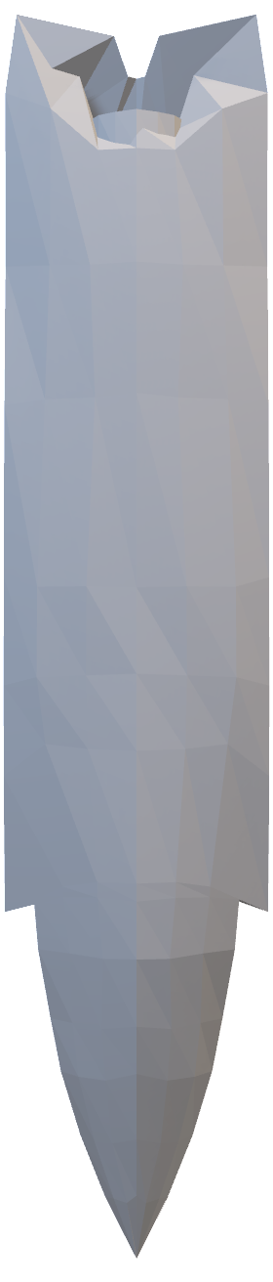

PLANEMAKER

Slide 19
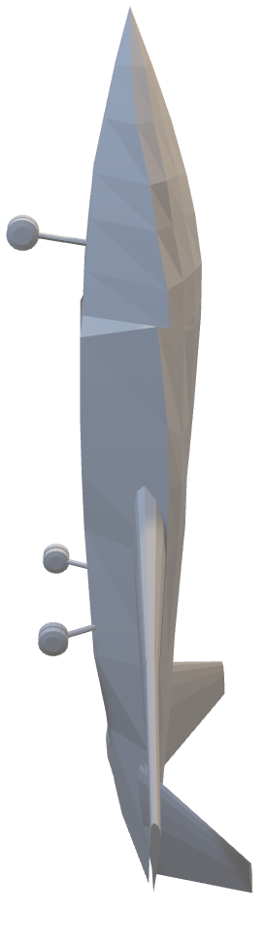
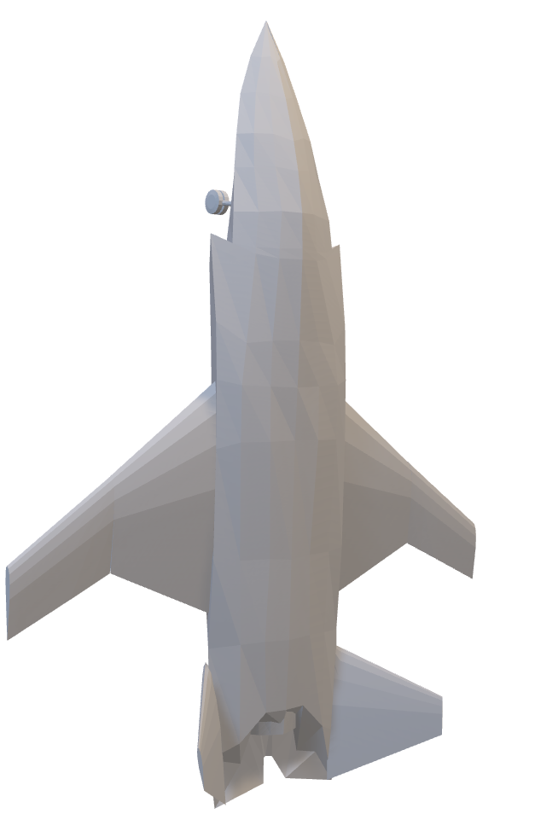
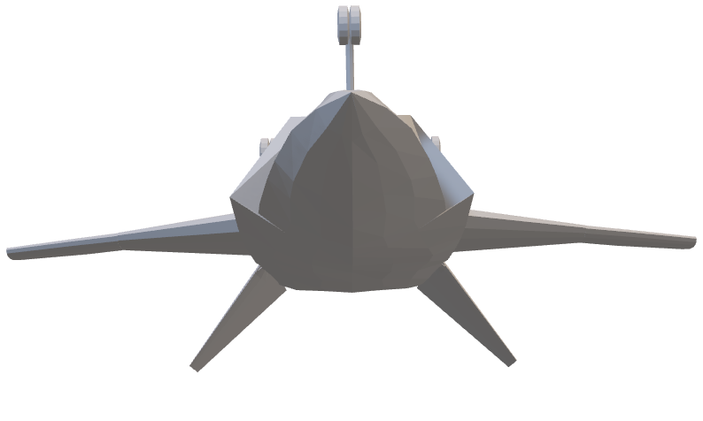
PLANEMAKER

Slide 20
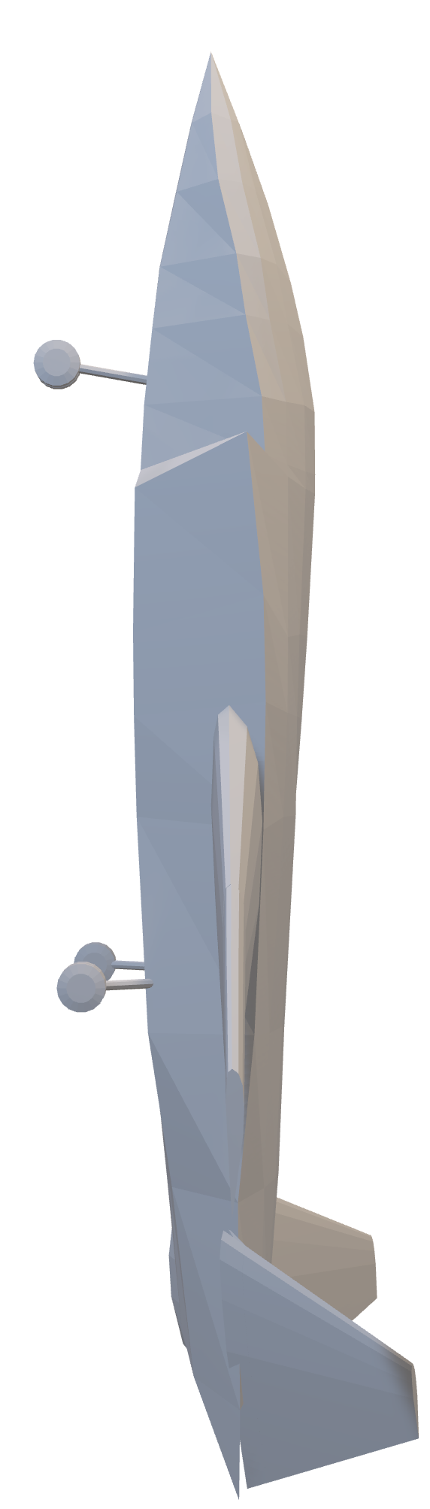

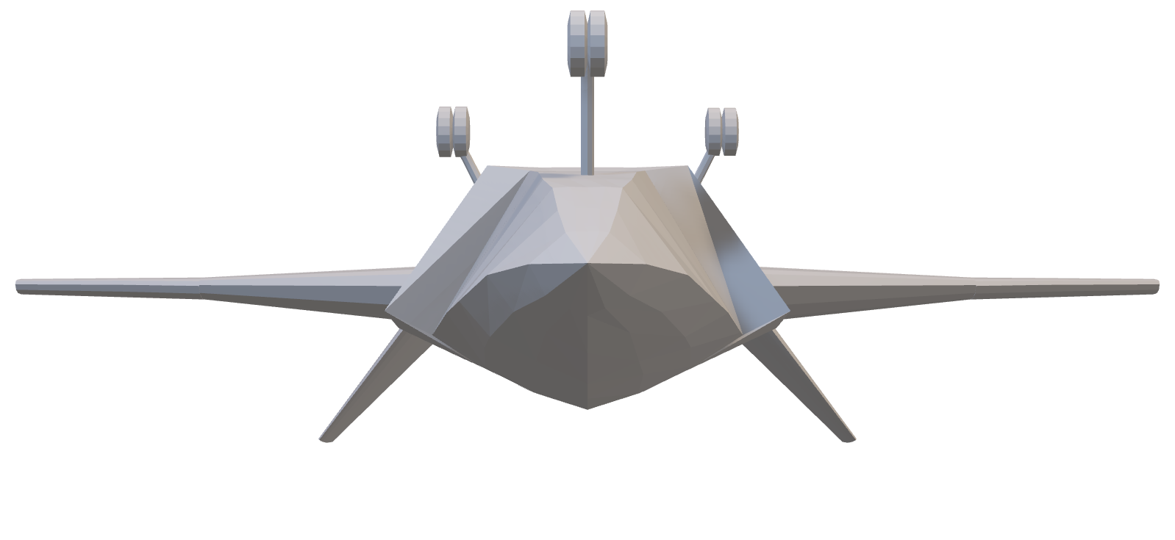

PLANEMAKER

Slide 21
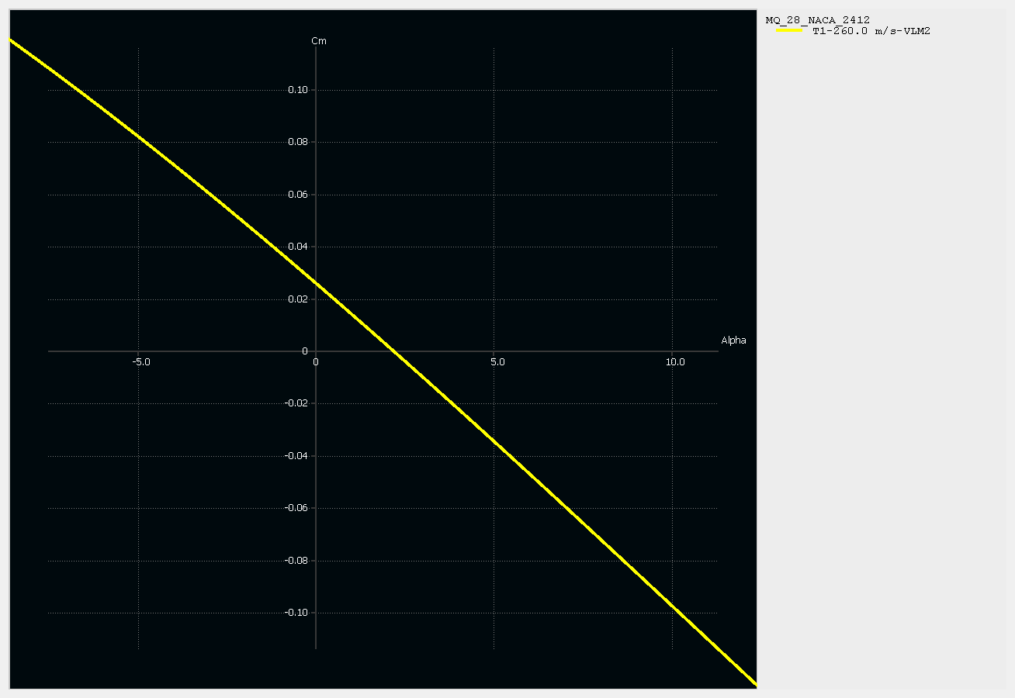
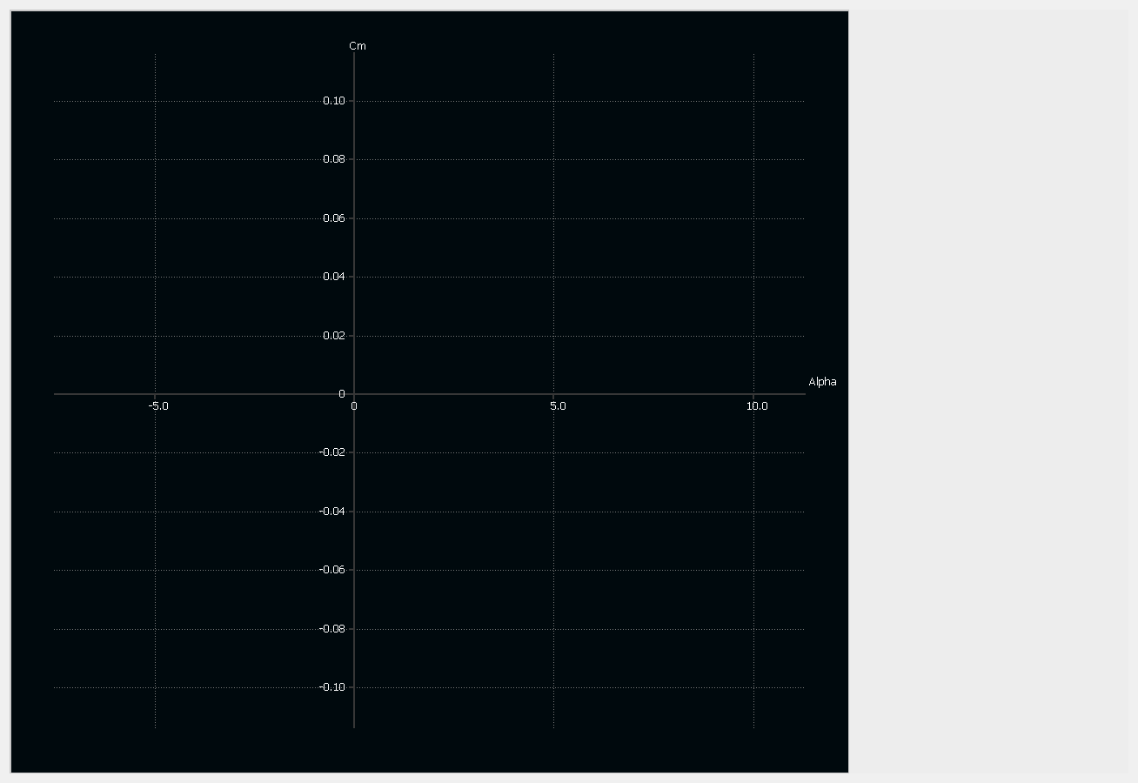
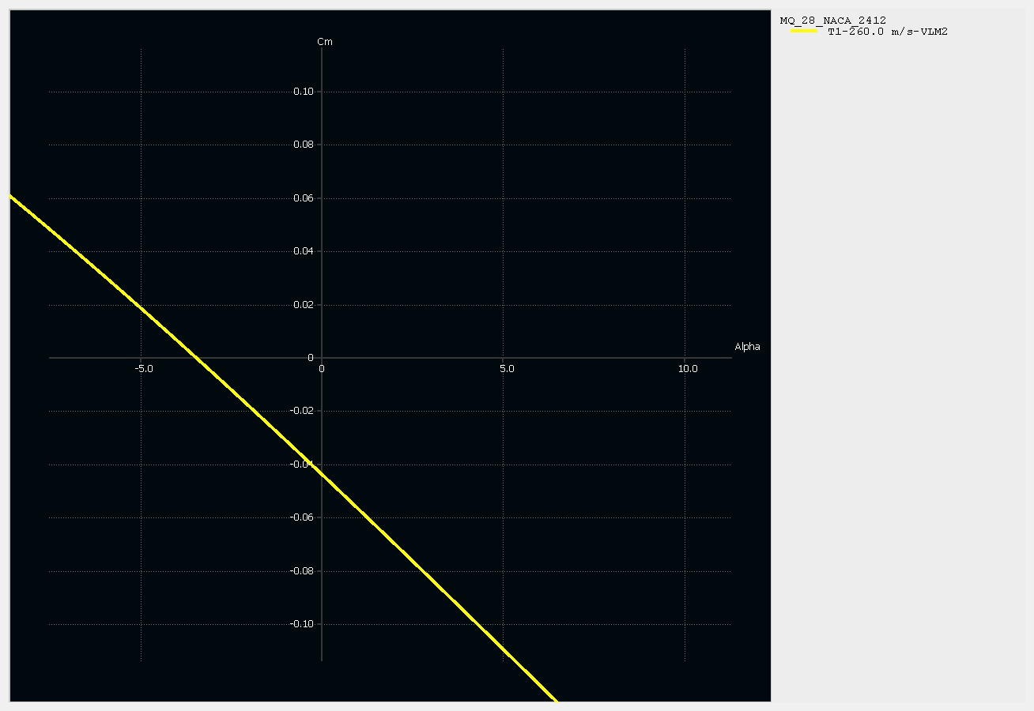


XFLR5 ANALYSIS
stable
Un
Tail Configuration
Graph Cm vs ⍺
[Un
stable]

Slide 22
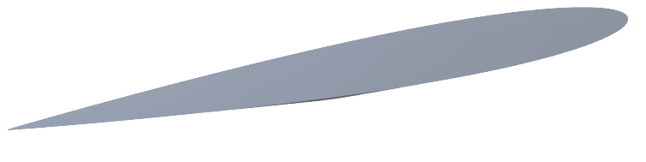
XFLR5 ANALYSIS
Graph Cm vs ⍺
[Un
trimmable]
-ve 8⁰ angle of

Slide 23


XFLR5 ANALYSIS
-ve 8 angle of incidence
⁰
Graph Cm vs ⍺
[Stable]

Slide 24
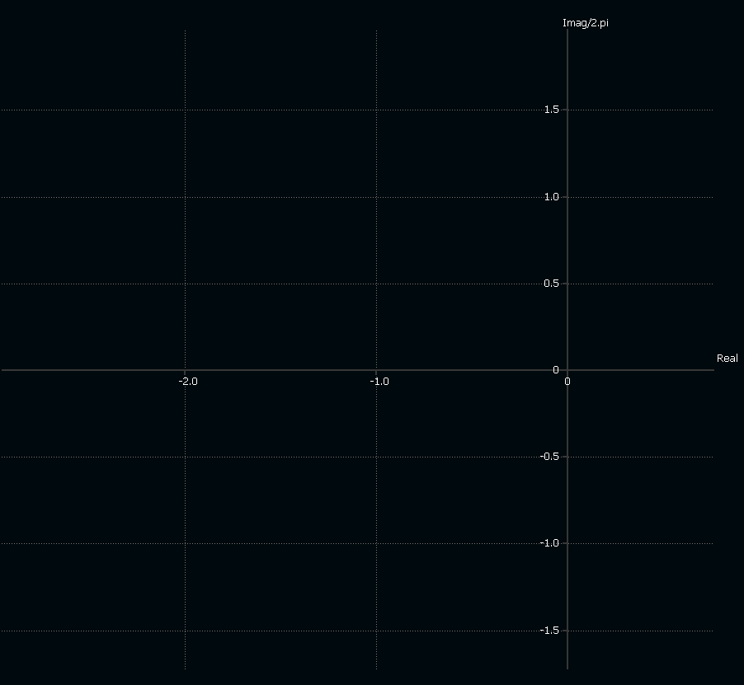


Spiral mode
Roll mode
Dutch roll mode
XFLR5 ANALYSIS
[Stability]
-3.0
-ve 8 angle of incidence
⁰
Lateral Stability root locus
Graph Cm vs ⍺

Slide 25
XFLR5 ANALYSIS
[Stability]
Spiral mode
Roll mode
Dutch roll mode
-3.0
-ve 8 angle of incidence
⁰
Stability root locus
Lateral
Graph Cm vs ⍺

Slide 26
XFLR5 ANALYSIS
[Stability]
Short Period mode
Phugoid mode
-3.0
-ve 8 angle of incidence
⁰
Longitudinal
Stability root locus
Graph Cm vs ⍺

Slide 27


XFLR5 ANALYSIS
Airfoil Selection
High stability
Low drag
Symmetric
⁰
⁰⁰⁹
V tail
Reduced Interference Drag
Reduced weight than conventional tail configuration
Enhanced Maneuverability
Graph Cm vs ⍺
[
stable]
-ve 8 angle of incidence
Good stability
Enhanced lift

Slide 28
XFLR5 ANALYSIS
Airfoil Selection
High stability
Low drag
Symmetric
⁰
⁰⁰⁹
V tail
Good stability
Enhanced lift
²⁴¹²

Slide 29
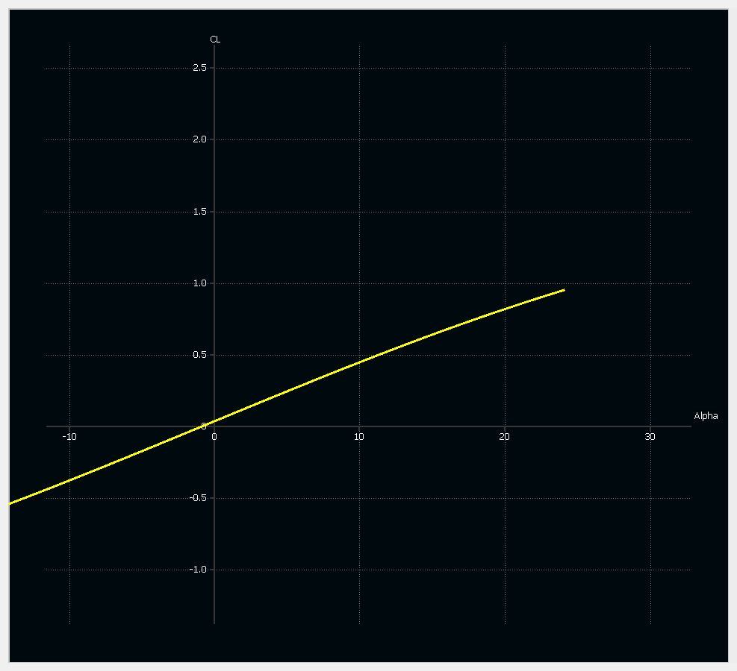


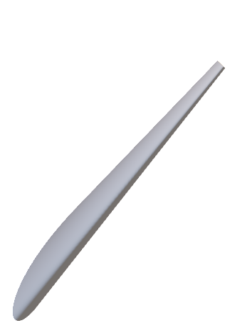
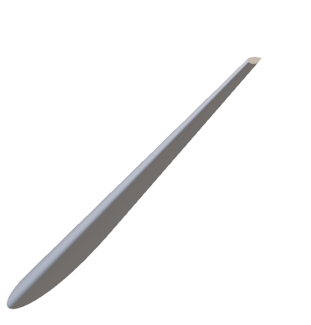
XFLR5 ANALYSIS
Configuration
Reduces adverse effects of transonic & supersonic flow
V tail
Reduced Interference Drag
Swept Wing
Increase Divergence Mach number
Reduced weight than conventional tail configuration
High maneuverability with low aspect ratio
Enhanced Maneuverability
Graph Cl vs ⍺

Slide 30
XFLR5 ANALYSIS
Configuration
Reduces adverse effects of transonic & supersonic flow
Reduced Interference Drag
Swept Wing
V tail
Increase Divergence Mach number
Reduced weight than conventional tail configuration
Graph Cl vs ⍺
High maneuverability with low aspect ratio
Enhanced Maneuverability

Slide 31


XFLR5 ANALYSIS
Configuration
Swept Wing
Reduces adverse effects of transonic & supersonic flow
Reduced Interference Drag
V tail
Increase Divergence Mach number
Reduced weight than conventional tail configuration
High maneuverability with low aspect ratio
Enhanced Maneuverability
Graph Cl vs ⍺

Slide 32


XFLR5 ANALYSIS
Configuration
Swept Wing
V tail
Reduces adverse effects of transonic & supersonic flow
Reduced Interference Drag
Increase Divergence Mach number
Reduced weight than conventional tail configuration
High maneuverability with low aspect ratio
Enhanced Maneuverability
Graph Cl vs ⍺

Slide 33
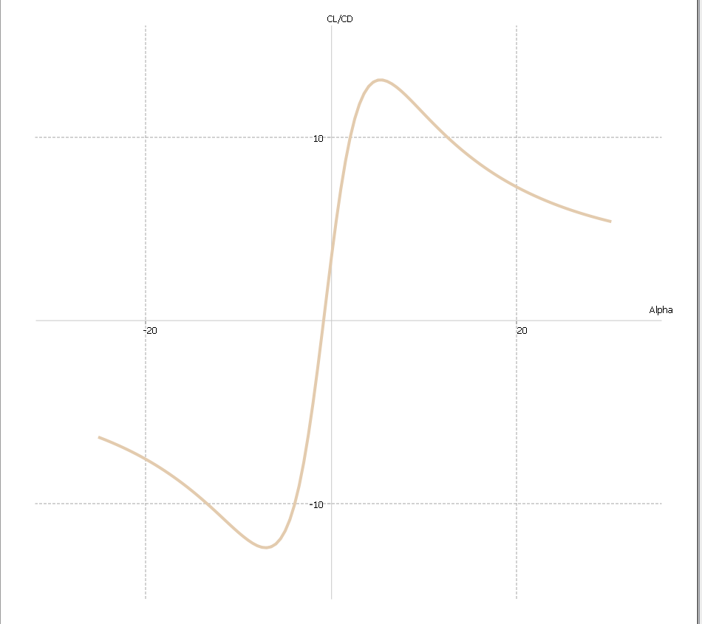
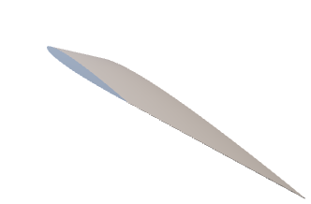
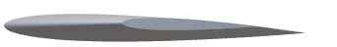
XFLR5 ANALYSIS
Configuration
Swept Wing
V tail
Reduces adverse effects of transonic & supersonic flow
Reduced Interference Drag
Increase Divergence Mach number
Reduced weight than conventional tail configuration
High maneuverability with low aspect ratio
Enhanced Maneuverability
Graph Cl/Cd vs ⍺
Graph Cl vs ⍺

Slide 34
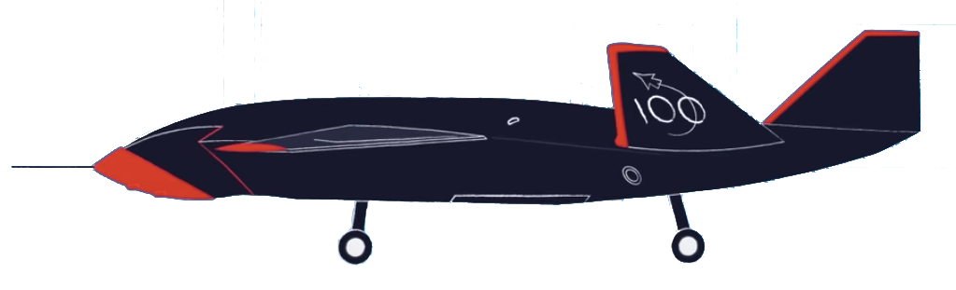

STABILITY TEST
High Altitude High Speed [Mode H]
Altitude – 44,000 ft (above MSL)
Speed – 171 knots (IAS)
Low Altitude Low Speed [Mode L]
Altitude – 16,000 ft (above MSL)
Speed – 155 knots (IAS)
*Images not to scale

Slide 35
STABILITY TEST
SPIRAL MODE
High Altitude High Speed [Mode H]
Altitude – 44,000 ft (above MSL)
Speed – 171 knots (IAS)
Low Altitude Low Speed [Mode L]
Altitude – 16,000 ft (above MSL)
Speed – 155 knots (IAS)
*Images not to scale

Slide 36
STABILITY TEST
Spiral Mode
High Altitude High Speed [Mode H]
Altitude – 44,000 ft (above MSL)
Speed – 171 knots (IAS)
Low Altitude Low Speed [Mode L]
Altitude – 16,000 ft (above MSL)
Speed – 155 knots (IAS)

Slide 37
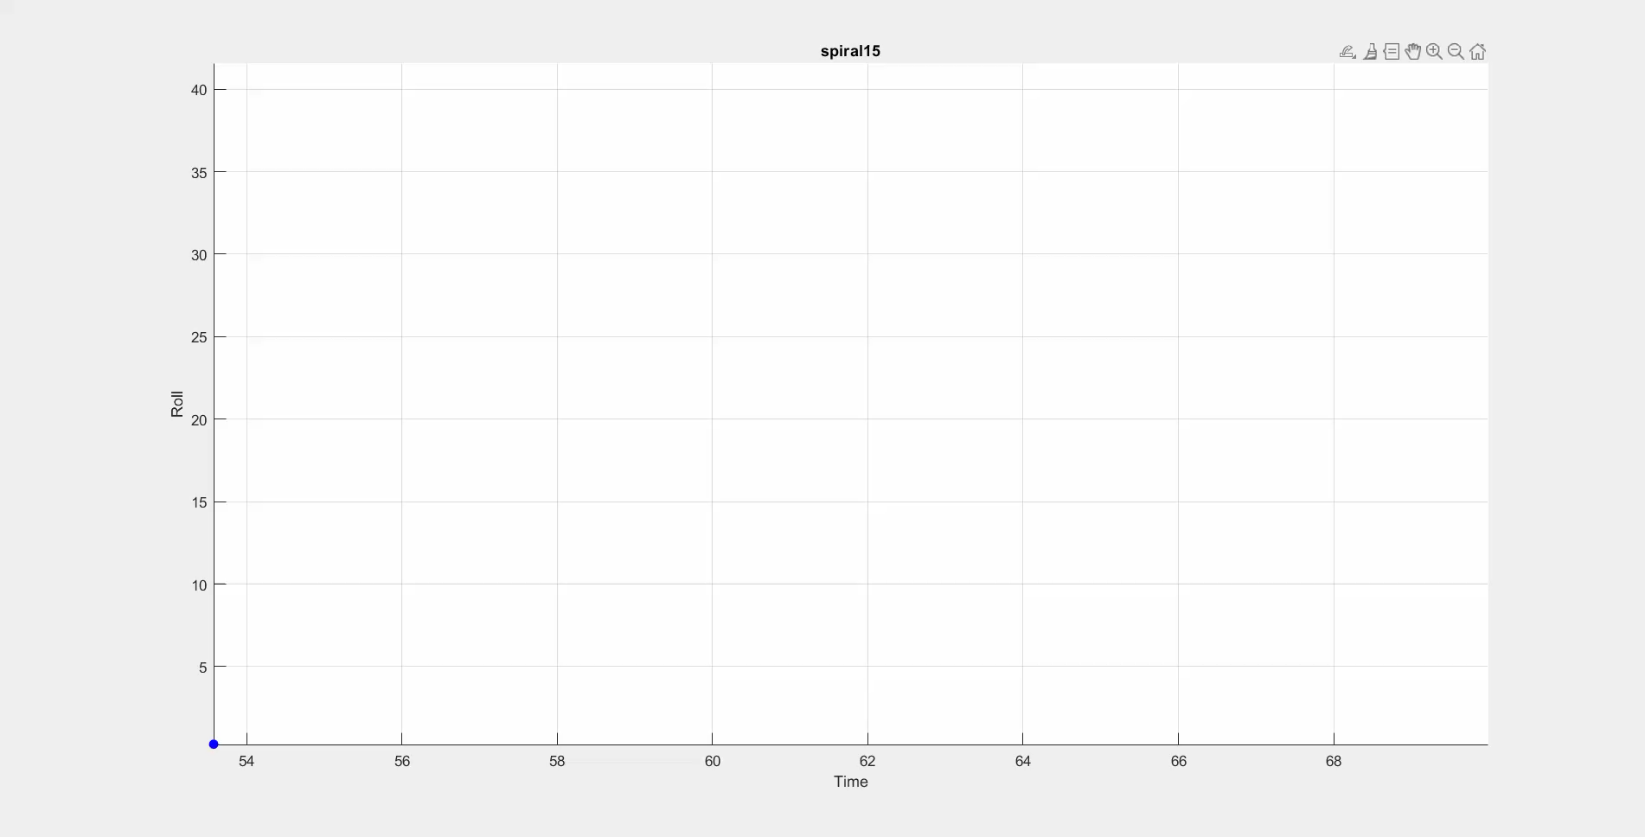
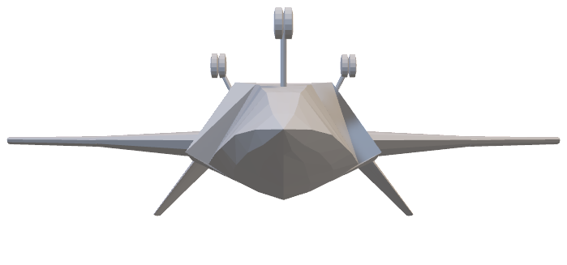
STABILITY TEST
Spiral Mode
High Altitude High Speed [Mode H]
Low Altitude Low Speed [Mode L]
15⁰

Slide 38

STABILITY TEST
Spiral Mode
High Altitude High Speed [Mode H]
Low Altitude Low Speed [Mode L]
15⁰

Slide 39
STABILITY TEST
Spiral Mode
High Altitude High Speed [Mode H]
Low Altitude Low Speed [Mode L]
30⁰

Slide 40
STABILITY TEST
Spiral Mode
High Altitude High Speed [Mode H]
Low Altitude Low Speed [Mode L]
45⁰

Slide 41
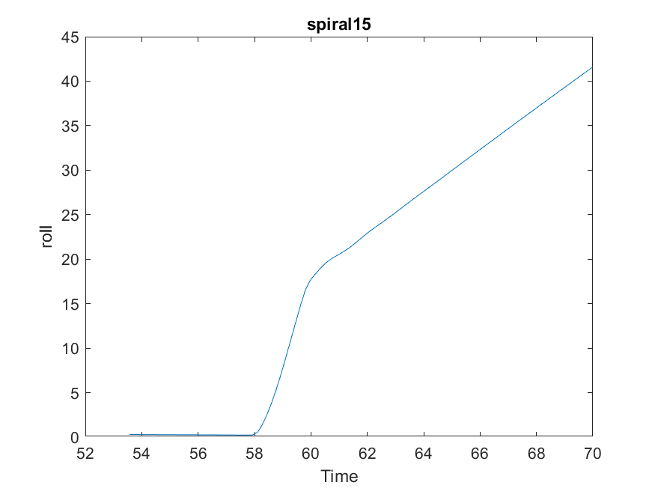
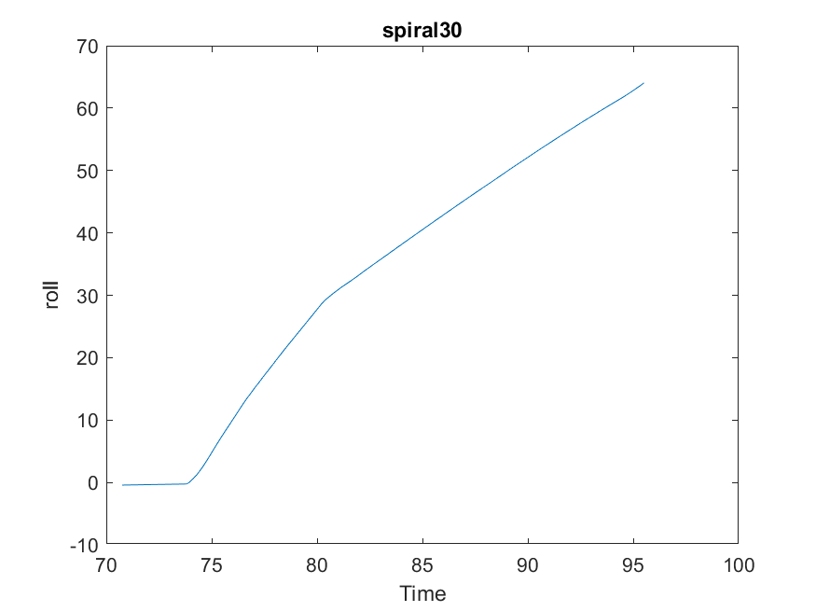
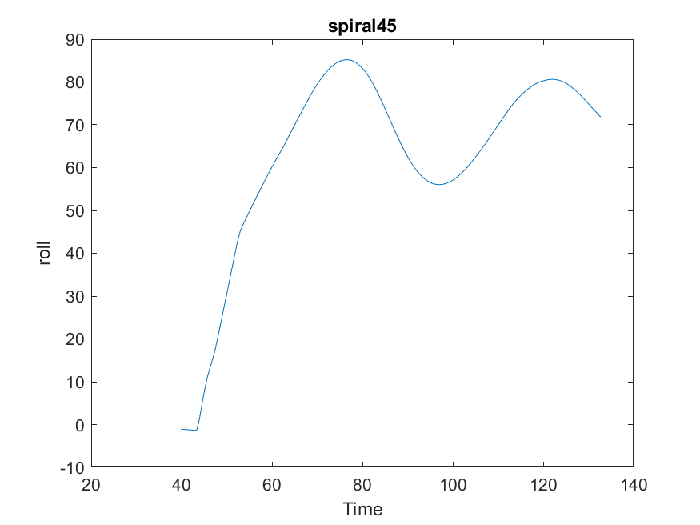
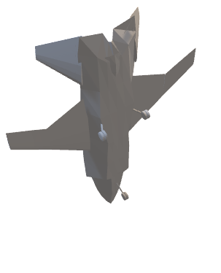
STABILITY TEST
Spiral Mode
High Altitude High Speed
[Mode H]
Low Altitude Low Speed
[Mode L]
15⁰
30⁰
45⁰

Slide 42
STABILITY TEST
Spiral Mode
High Altitude High Speed
[Mode H]
Low Altitude Low Speed
[Mode L]
15⁰
30⁰
45⁰
Graph Roll vs Time

Slide 43
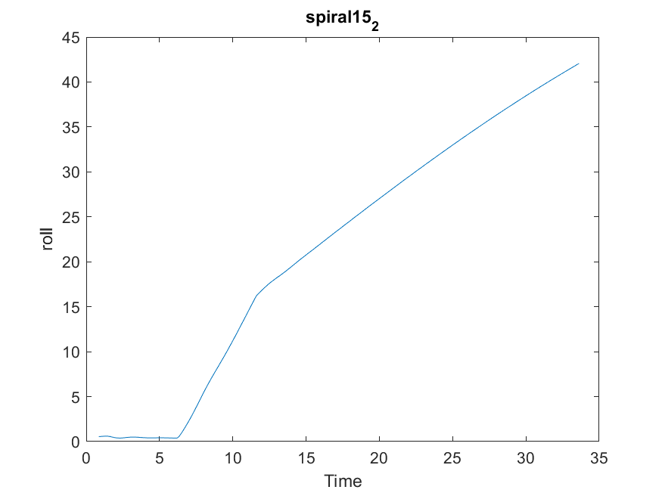
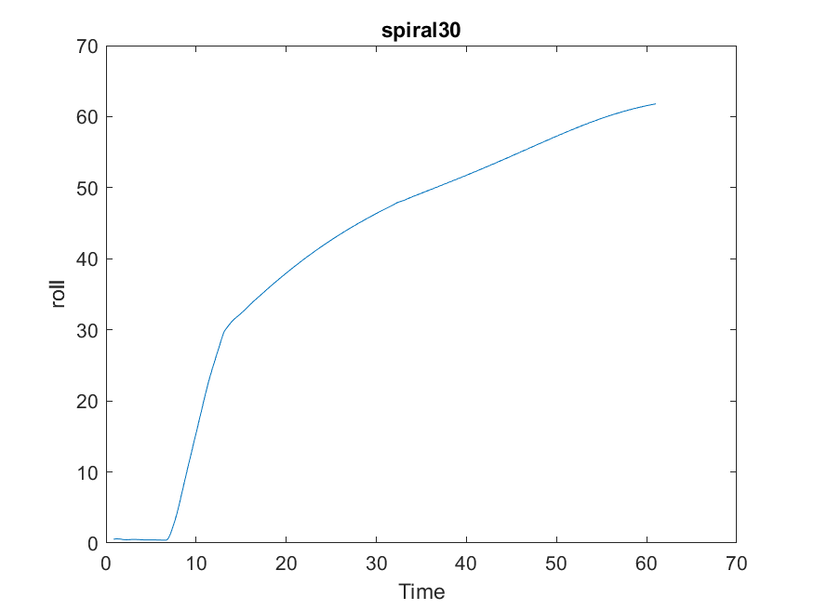
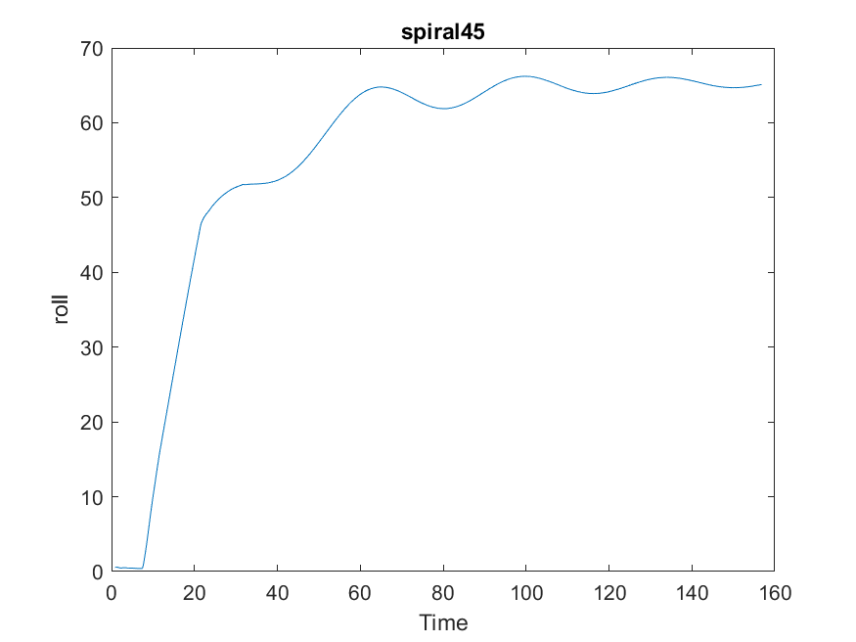
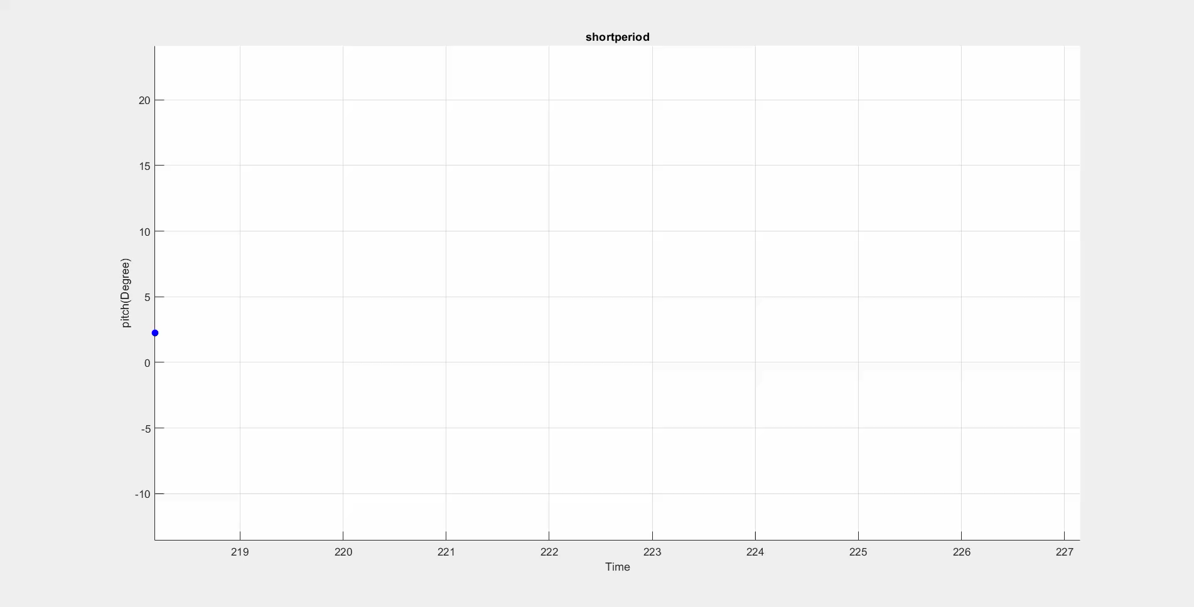
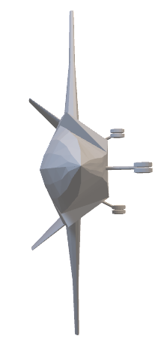
STABILITY TEST
Spiral Mode
[Mode H]
[Mode L]
15⁰
30⁰
45⁰
Graph Roll vs Time

Slide 44
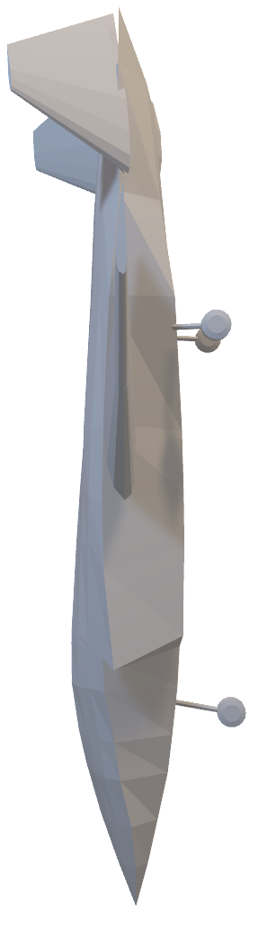
STABILITY TEST
Short Period Mode
High Altitude High Speed [Mode H]
High Altitude High Speed
[Mode H]
Low Altitude Low Speed
[Mode L]
Low Altitude Low Speed [Mode L]
15⁰
30⁰
45⁰
Pitch Doublet

Slide 45
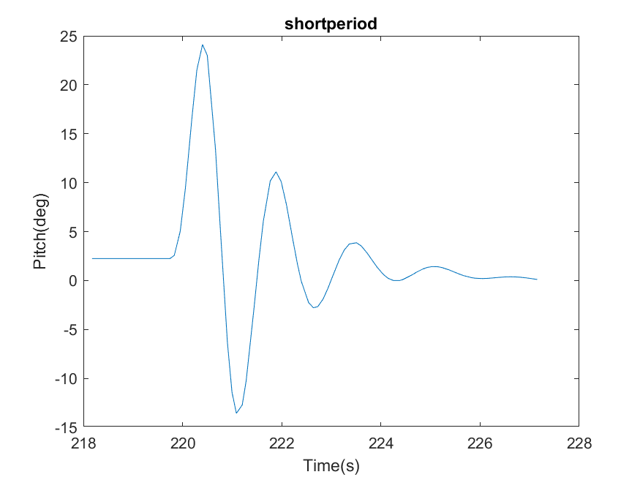
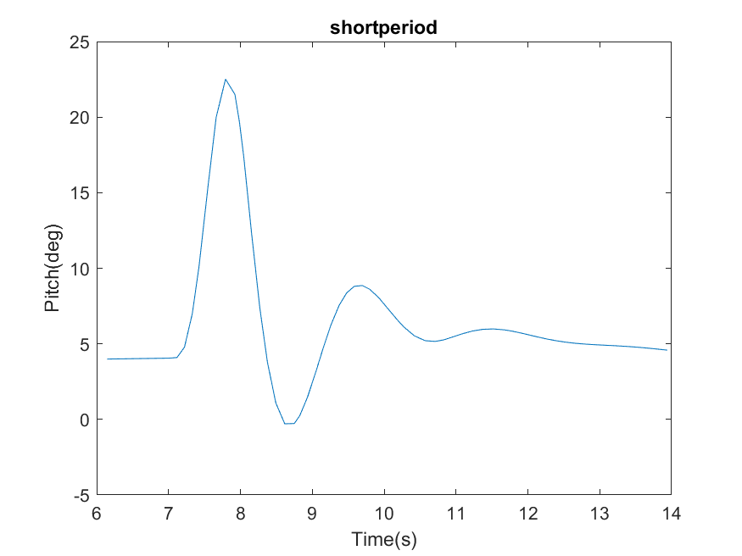
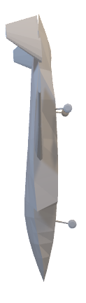
STABILITY TEST
Short Period Mode
High Altitude High Speed
[Mode H]
Low Altitude Low Speed
[Mode L]
Graph Pitch vs Time
Pitch Doublet

Slide 46
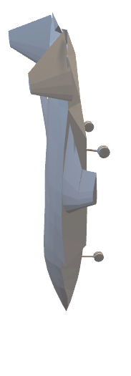
Low Altitude Low Speed
STABILITY TEST
Short Period Mode
High Altitude High Speed
[Mode H]
[Mode L]
Graph Pitch vs Time

Slide 47
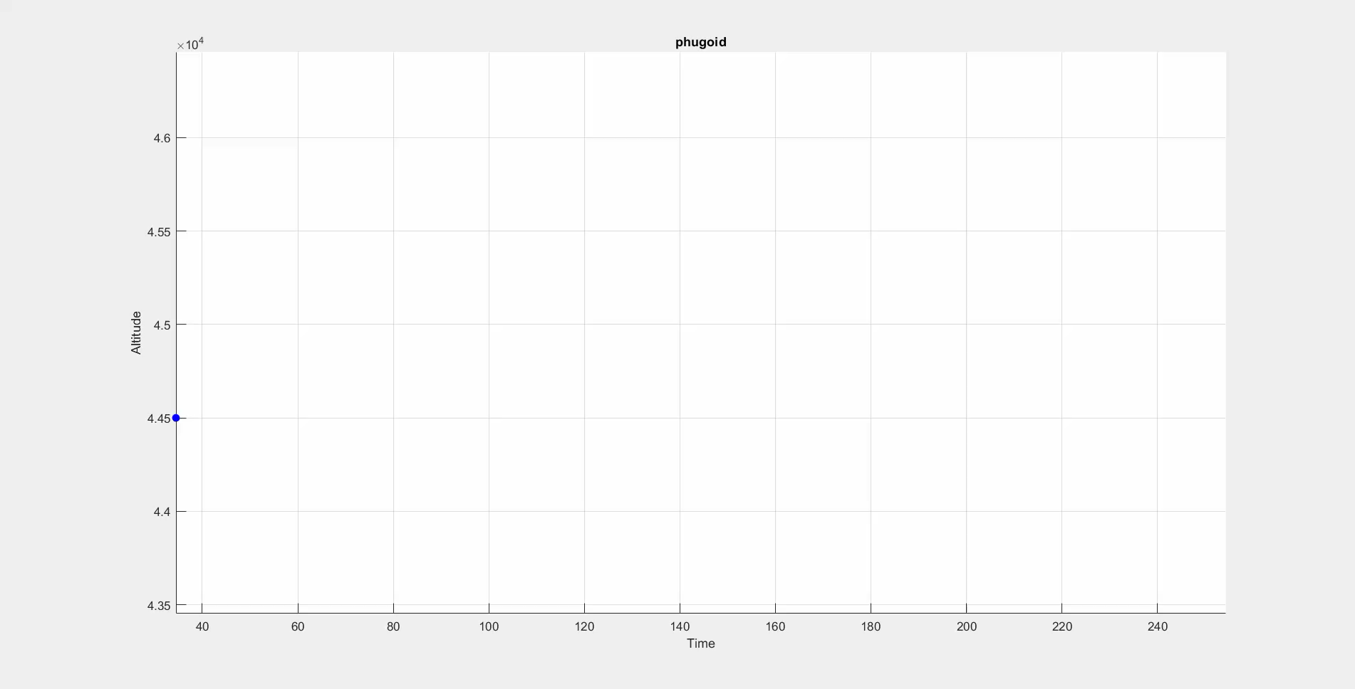
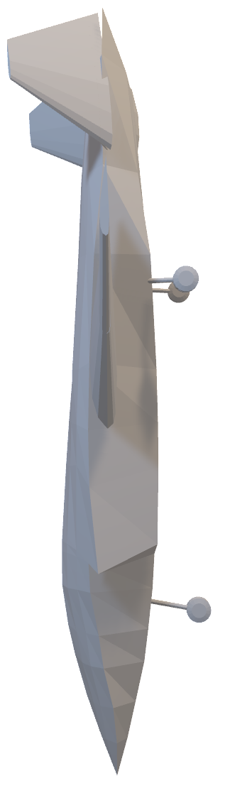
STABILITY TEST
Phugoid Mode
High Altitude High Speed [Mode H]
Low Altitude Low Speed [Mode L]
20⁰ Nose Up , decrease in velocity

Slide 48
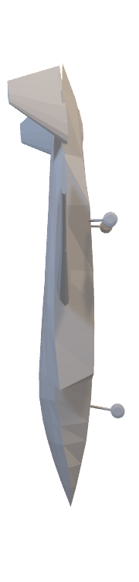
STABILITY TEST
Phugoid Mode
High Altitude High Speed [Mode H]
Low Altitude Low Speed [Mode L]
20⁰ Nose Up , 10% decrease in velocity

Slide 49
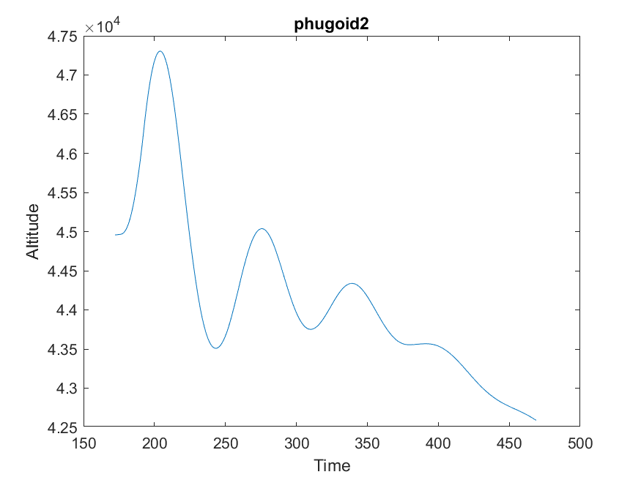
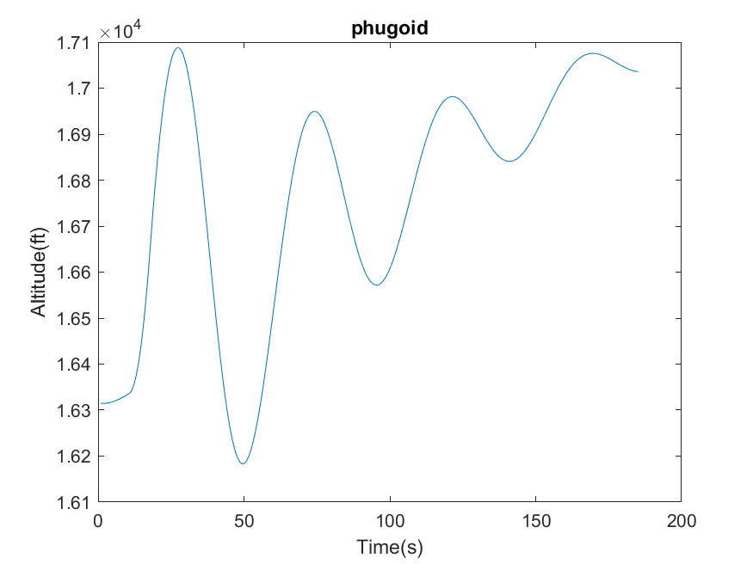
STABILITY TEST
Phugoid Mode
High Altitude High Speed
[Mode H]
Low Altitude Low Speed
[Mode L]
20⁰ Nose Up , 10% decrease in velocity
Graph Altitude vs Time

Slide 50
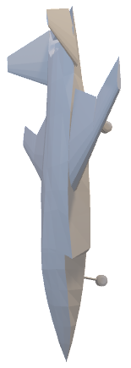
Low Altitude Low Speed
STABILITY TEST
Phugoid Mode
High Altitude High Speed
[Mode H]
[Mode L]
Graph Altitude vs Time

Slide 51
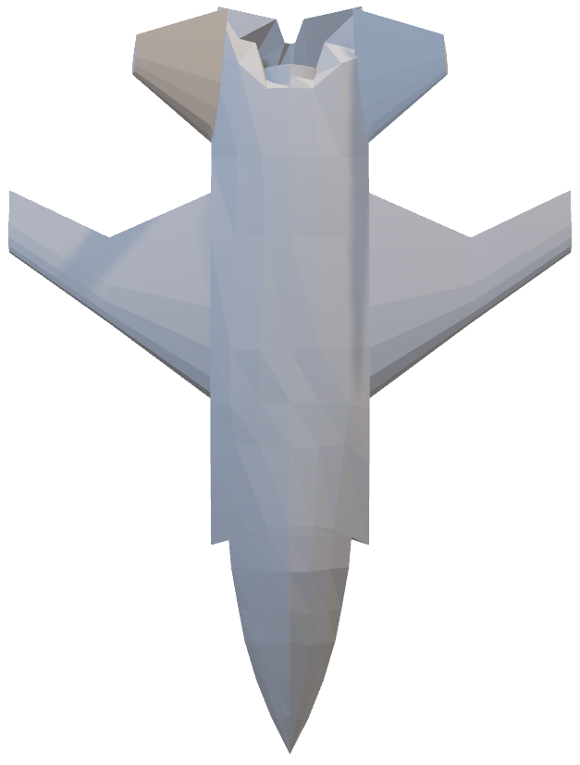
STABILITY TEST
Dutch Roll
High Altitude High Speed [Mode H]
Low Altitude Low Speed [Mode L]
Rudder Doublet

Slide 52
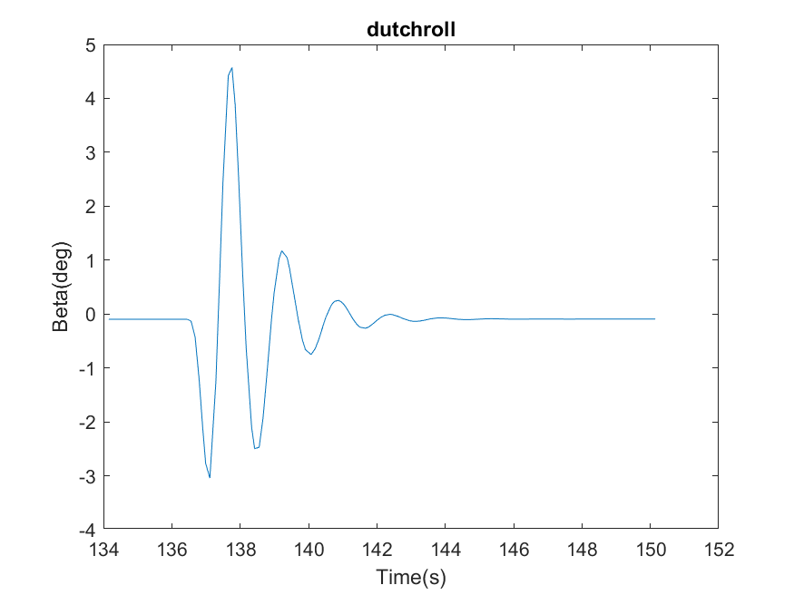


STABILITY TEST
Dutch Roll
High Altitude High Speed
[Mode H]
Low Altitude Low Speed
[Mode L]
Rudder Doublet
Graph β vs Time

Slide 53
Low Altitude Low Speed
STABILITY TEST
Dutch Roll
High Altitude High Speed
[Mode H]
[Mode L]
Graph β vs Time
THANK YOU

Slide 54
THANK YOU

Slide 55

APPENDIX I
 | Wing Section | Tail Section
Airfoil | NACA 2412 | NACA 0009
MAC | 2.194m | 0.6
Aspect Ratio | 6.599 | 2.2
Wingspan | 9.420m | 0.273
Incidence Angle | 0 | -8
Sweep | 24 | 12
Area | 13.447 $m^{2}$ | 5.152$m^{2}$

Slide 56
APPENDIX II
Takeoff weight | 2950 kg
Empty weight | 1371 kg
Fuel weight | 579 kg
Payload weight | 700 kg
Avionics weight | 300 kg
Engine weight | 300 kg

Slide 57
APPENDIX III
 | High Altitude | Low Altitude
Speed | 171 knots | 155 knots
Altitude | 44000 ft. | 16000 ft.

Slide 58
APPENDIX IV
 | High Altitude |  |  | Low Altitude
Modes | Dutch Roll | Short Period | Phugoid | Dutch Roll | Short Period | Phugoid
Frequency | 0.6609 | 0.6428 | 0.0160 | 0.4640 | 0.5370 | 0.0237
Damping Ratio | - | 0.1 | 0.3159 | 0.0154 | 0.0470 | -
Subsidence Ratio | - | 0.5318 | 0.1234 | 0.9071 | 0.7438 | -
Max. Amplitude | 4.5718 | 24.1132 | 47304.6680 | 6.2231 | 22.5106 | 17087.8652

